Slide 1

Back to the Future: How LTI Advantage Enables the Boutique LMS Charles R. Severance, SakaiLMS.org Julianne Morgan, University of Dayton

Slide 2
Show of Hands
Running Canvas, Blackboard, or Brightspace?
How many LMS transitions since 2000?
Would you like to avoid an LMS transition for at least five years?
Notes:
SD

Slide 3



Innovation Conundrum
Most Faculty
Upload PowerPoint
Have some due dates
Don't move my cheese
Campus IT
Simplicity
Stability
Scalability
Cost
A Few Faculty
I have an idea...
I want to teach using...
Is there a feature that lets me..
Can we add a feature?

Slide 4

Future of Learning Summit

Slide 5
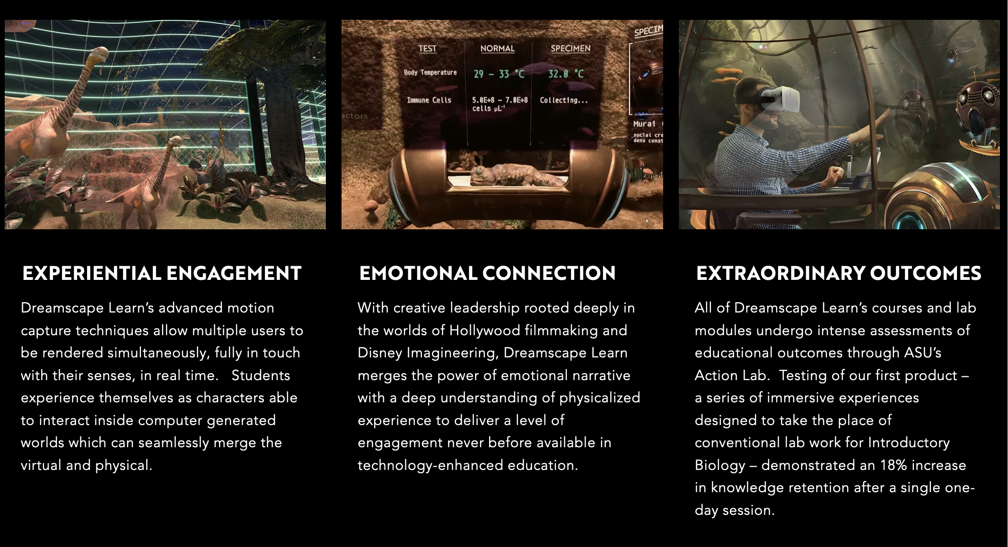
ASU Dreamscape Learn

Slide 6
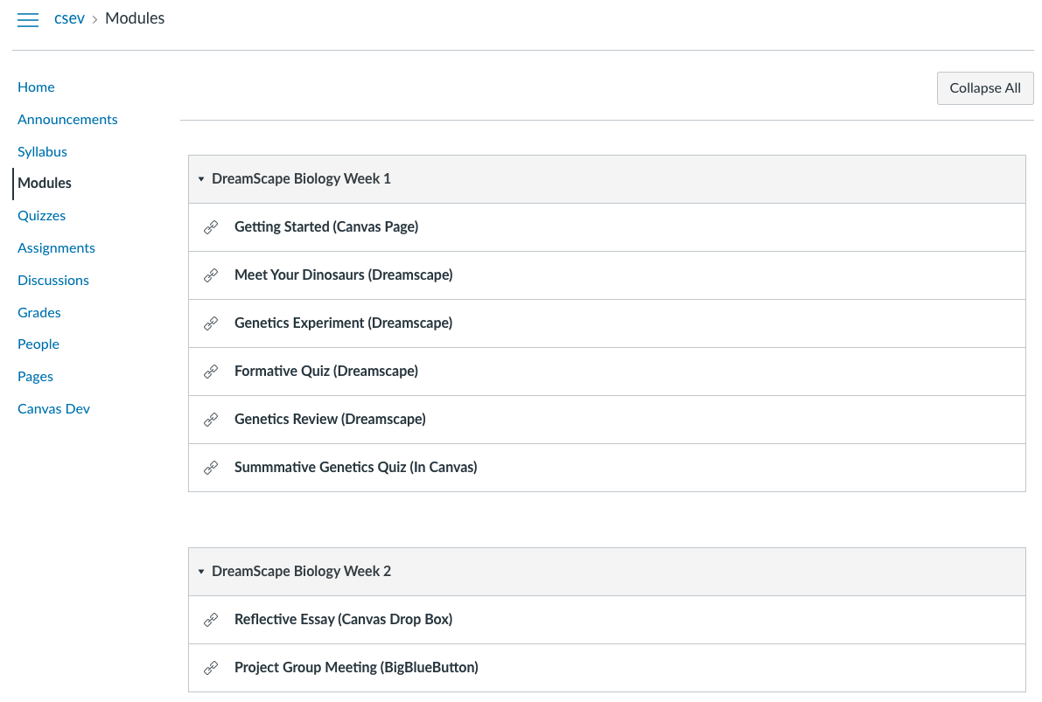
Dreamscape in Canvas

Slide 7
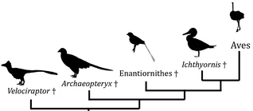
Evolution of the LMS
Roster
Gradebook
Reflection
Essay
Drop Box
Summative
Must Watch
Exercise
Forum
Q/A
Reflection
Assignments
Essay
Drop Box
Quizzes
Formative
Summative
Videos
Must Watch
Optional
LTI 1.1 Links
Reading
Exercise
Roster
Gradebook
Reflection
Essay
Drop Box
Summative
Must Watch
Exercise
Launch
L T I
A
D
V
A
N T A G E
Roster
Gradebook
Reflection
Essay
Drop Box
Summative
Must Watch
Exercise
Forum
Q/A
Reflection
Assignments
Essay
Drop Box
Quizzes
Formative
Summative
Content
Reading
Exercise
Videos
Must Watch
Optional
SIS
Roster
Gradebook
Reflection
Essay
Drop Box
Summative
Must Watch
Forum
Q/A
Reflection
Assignments
Essay
Drop Box
Quizzes
Formative
Summative
Videos
Must Watch
Optional
Roster
Gradebook
Reflection
Essay
Drop Box
Summative
Must Watch
Forum
Q/A
Reflection
Assignments
Essay
Drop Box
Quizzes
Formative
Summative
Gamified
LMS
L T I
A
D
V
A
N T A G E
Launch
Roster
Gradebook
Reflection
Essay
Drop Box
Summative
Must Watch
Exercise
L T I
A
D
V
A
N T A G E
Virtual
Reality
LMS
Locally hosted
Max Privacy LMS
Scenario-based
LMS
L T I
Tool
Reading
Exercise
Coursera
An LMS
Pilot

Slide 8
LTI Advantage
Roster
Gradebook
Reflection
Essay
Drop Box
Summative
Must Watch
Exercise
Launch
L T I
A
D
V
A
N T A G E
Roster
Gradebook
Reflection
Essay
Drop Box
Summative
Must Watch
Exercise
Forum
Q/A
Reflection
Assignments
Essay
Drop Box
Quizzes
Formative
Summative
Content
Reading
Exercise
Videos
Must Watch
Optional
Portal
SSO
SIS
Record
Launch
Deep Linking
Names and Roles
Assignments and Grades
Pedagogy
and User Experience
Notes:
SD

Slide 9
A Pluggable 2025
SIS
Gamified LMS
Max Privacy LMS
Coursera / edX
VR LMS
Scenario-based
Your "next" LMS
Gamified
LMS
L T I
A
D
V
A
N T A G E
Launch
Roster
Gradebook
Reflection
Essay
Drop Box
Summative
Must Watch
Exercise
L T I
A
D
V
A
N T A G E
Virtual
Reality
LMS
Locally hosted
Max Privacy LMS
Scenario-based
LMS
Coursera
An LMS
Pilot
Notes:
SD

Slide 10
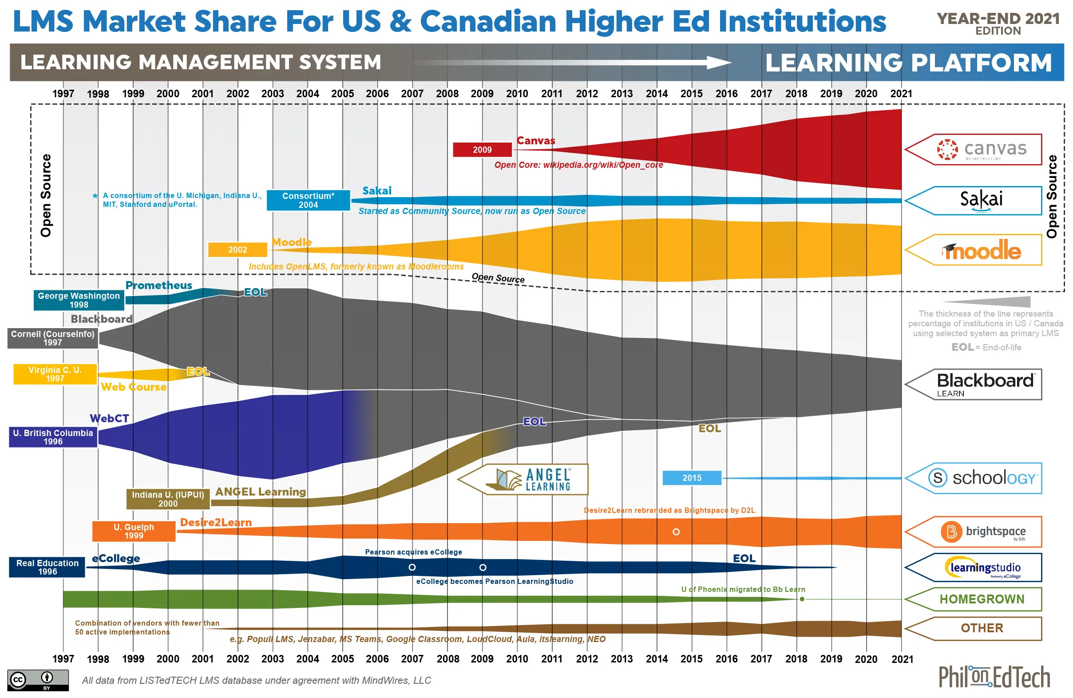
LMS Squid Diagram 2021

Slide 11
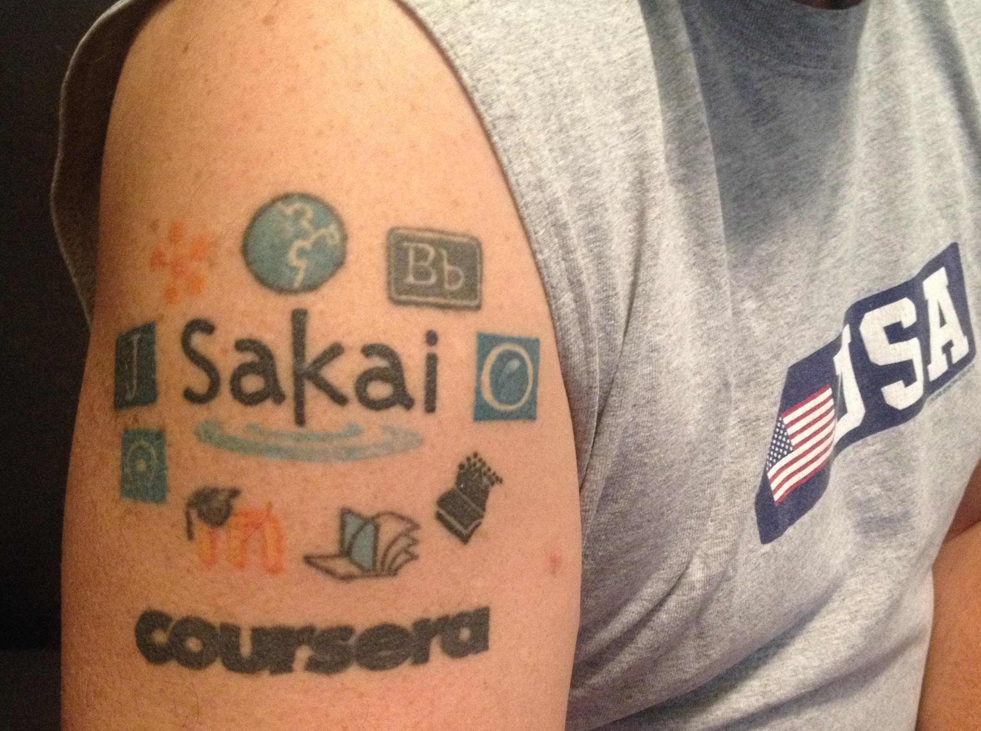
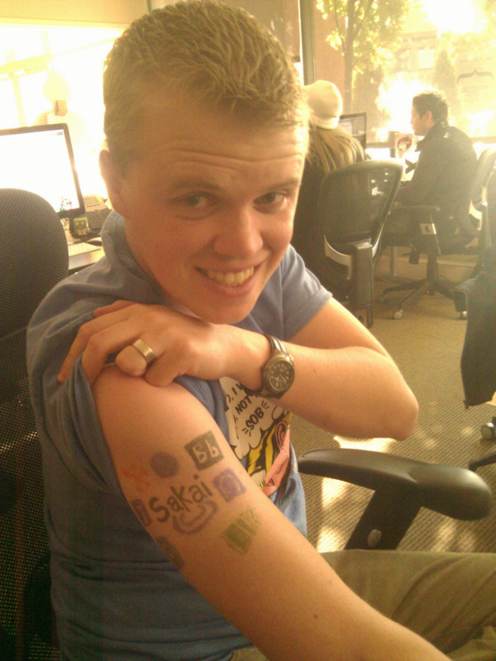
SakaiLMS.org R/D Impact
Founded IMS Learning Tools Interoperability WG in 2005
Founded IMS Common Cartridge WG in 2006
Provides open-source reference implementations
Free test platform for LTI advantage
Extensive mentoring of LTI Tool Providers
Notes:
SD

Slide 12
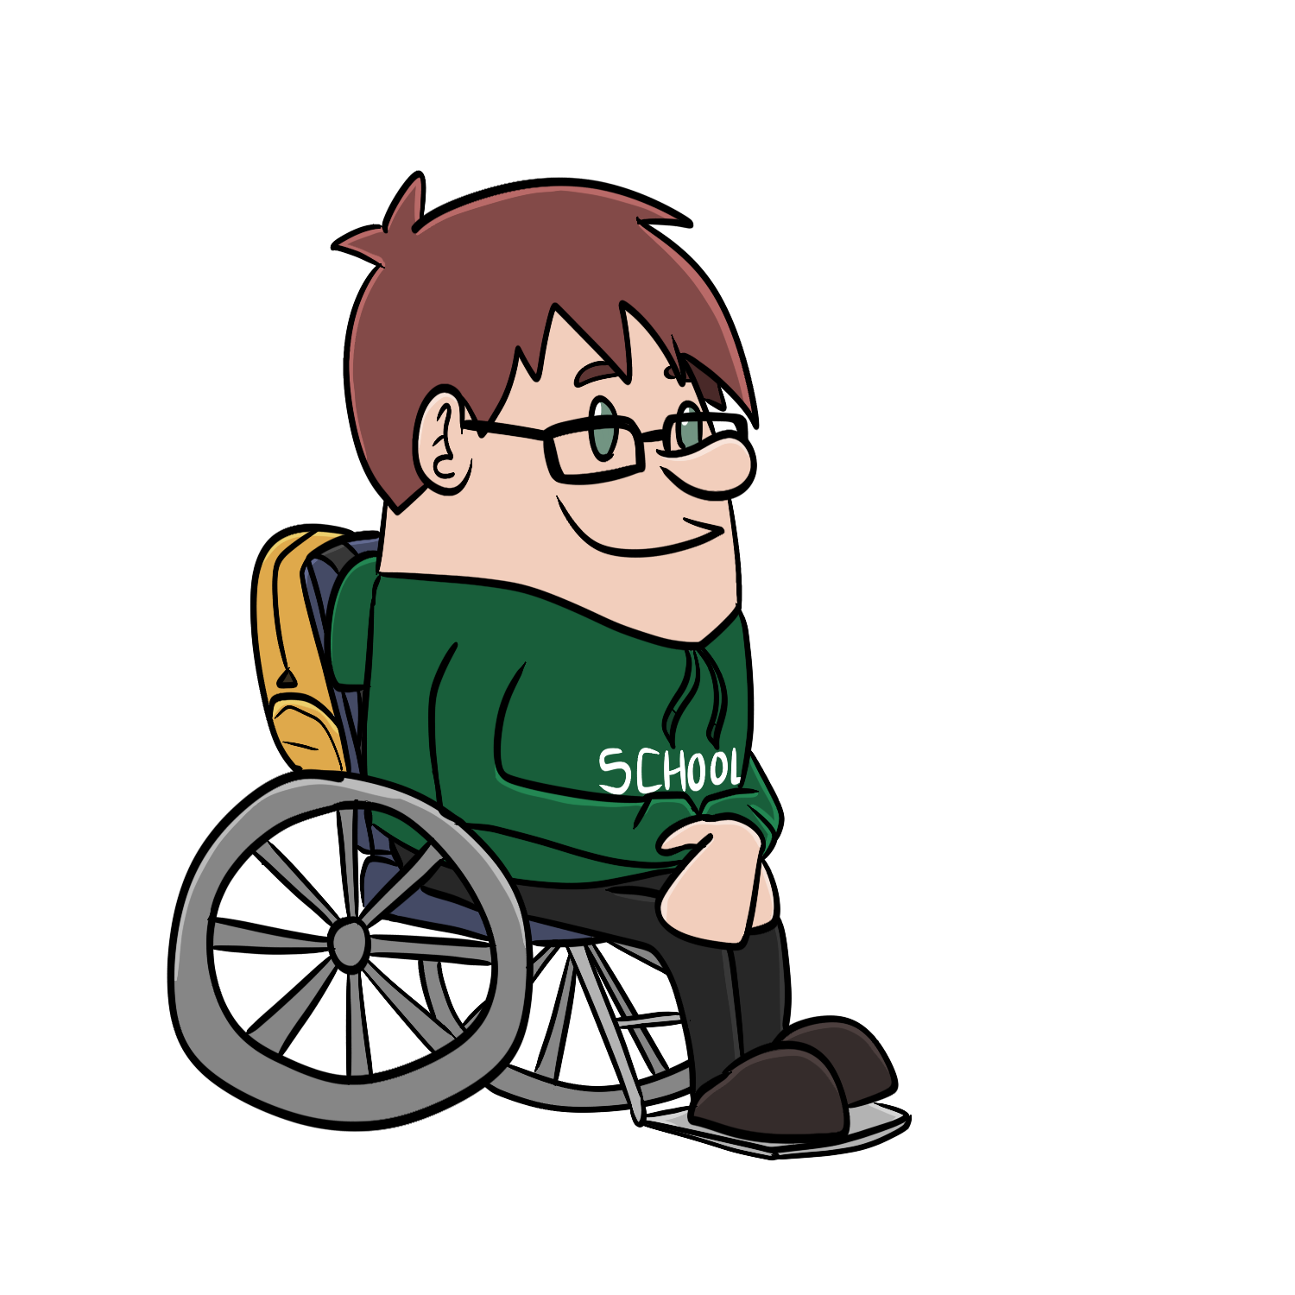



Student
Information
System
Canvas
Blackboard
Brightspace
...
LTI Advantage
SSO / Launch
Synchronized roster
Synchronized grades
Deep Linking

Slide 13

Advantage: SakaiLMS Best LMS for Learning
Notes:
Hi all. I’m Josh Wilson, a leader in the Sakai Community and COO at Sakai Commercial Affiliate Longsight, Inc. Here’s where I tell you a bit about what makes Sakai the Best LMS for Learning, and why it’s worth adding to the instructional technology portfolio at your institution. We’ve got 4 overarching points to make here.
Sakai provides Meaningful Learning
Sakai always places Faculty and Students First
Sakai’s innovative evolution is Participatory
Sakai is Best for Privacy.

Slide 14

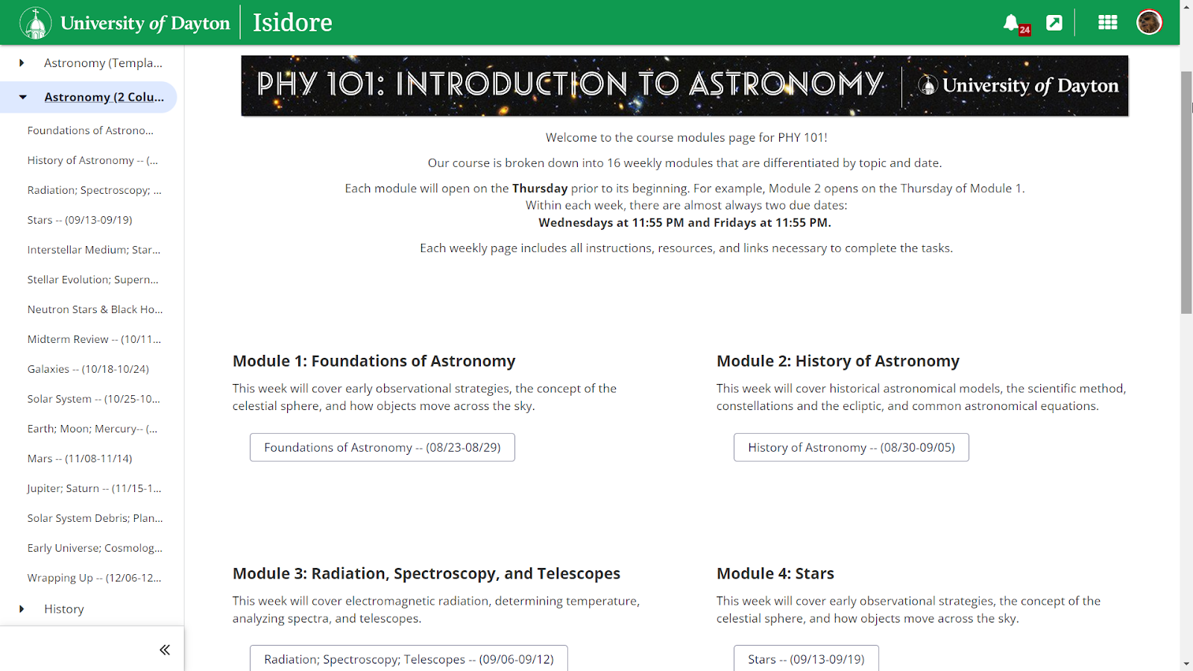
Meaningful Learning
Notes:
Sakai enables Meaningful Learning.
Let me start by sharing a teaching story that focuses on Sakai’s Lesson’s tool, and just one way in which it facilitates great student learning.

Slide 15
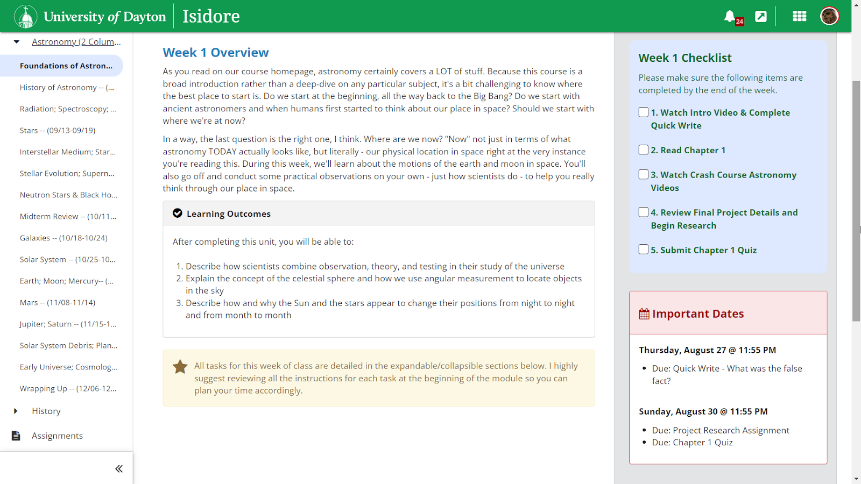
Meaningful Learning
Notes:
Sakai enables Meaningful Learning.
Let me start by sharing a teaching story that focuses on Sakai’s Lesson’s tool, and just one way in which it facilitates great student learning.

Slide 16
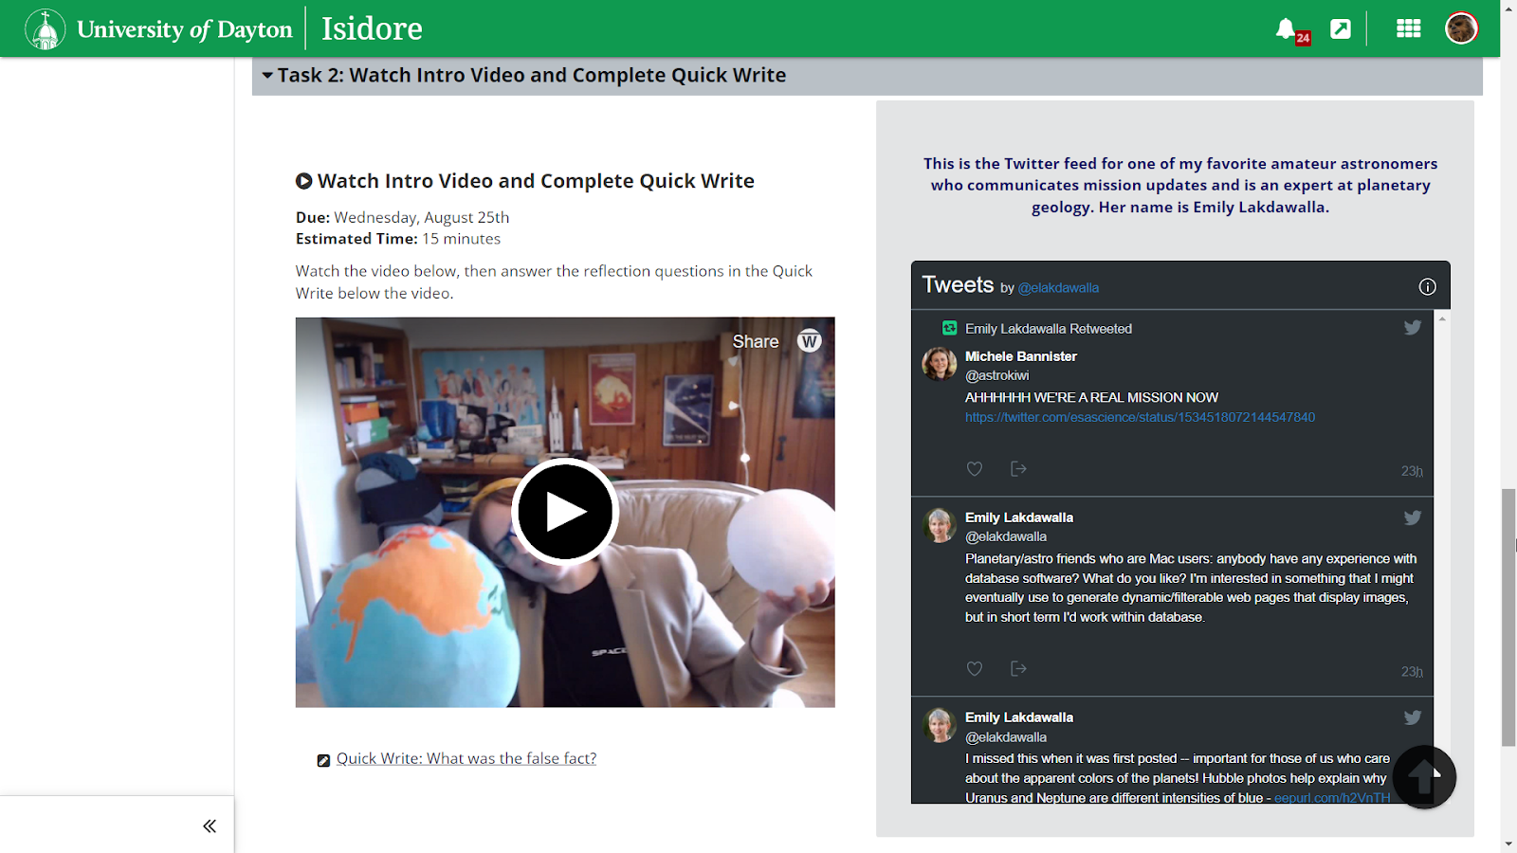
Meaningful Learning
Notes:
Sakai enables Meaningful Learning.
Let me start by sharing a teaching story that focuses on Sakai’s Lesson’s tool, and just one way in which it facilitates great student learning.

Slide 17

Meaningful Learning
Sakai Lessons: Deep student learning
Learn more: bit.ly/Sakai-meaningful-learning
Notes:
Let me share one teaching story with you.
This is Marisa Sullivan, psychology instructor and coordinator of distance learning at Durham Technical Community College in NC.
She leverages student content authoring capabilities in Lessons for a digital levelling-up on the traditional research paper.
Because students enjoy the work of presenting, organizing, and designing their content using Lessons – both written narrative and media – they learn more than they would from a traditional assignment.
Let’s hear Marisa explain in her own words.

Slide 18
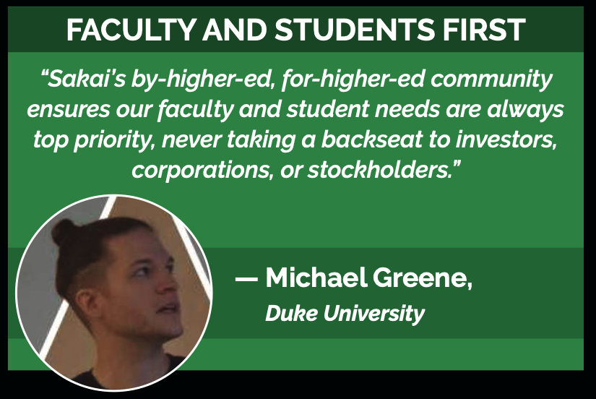
Notes:
Sakai innovates and evolves because of this focus on faculty and students first.
Sakai Community members receive input and suggestions directly from instructors and students at their institutions, and those ideas shape the forward progress of the product.
A great example of this is the all-new tool Sakai Conversations, which emerged thanks to a great deal of thought leadership from Duke University.

Slide 19
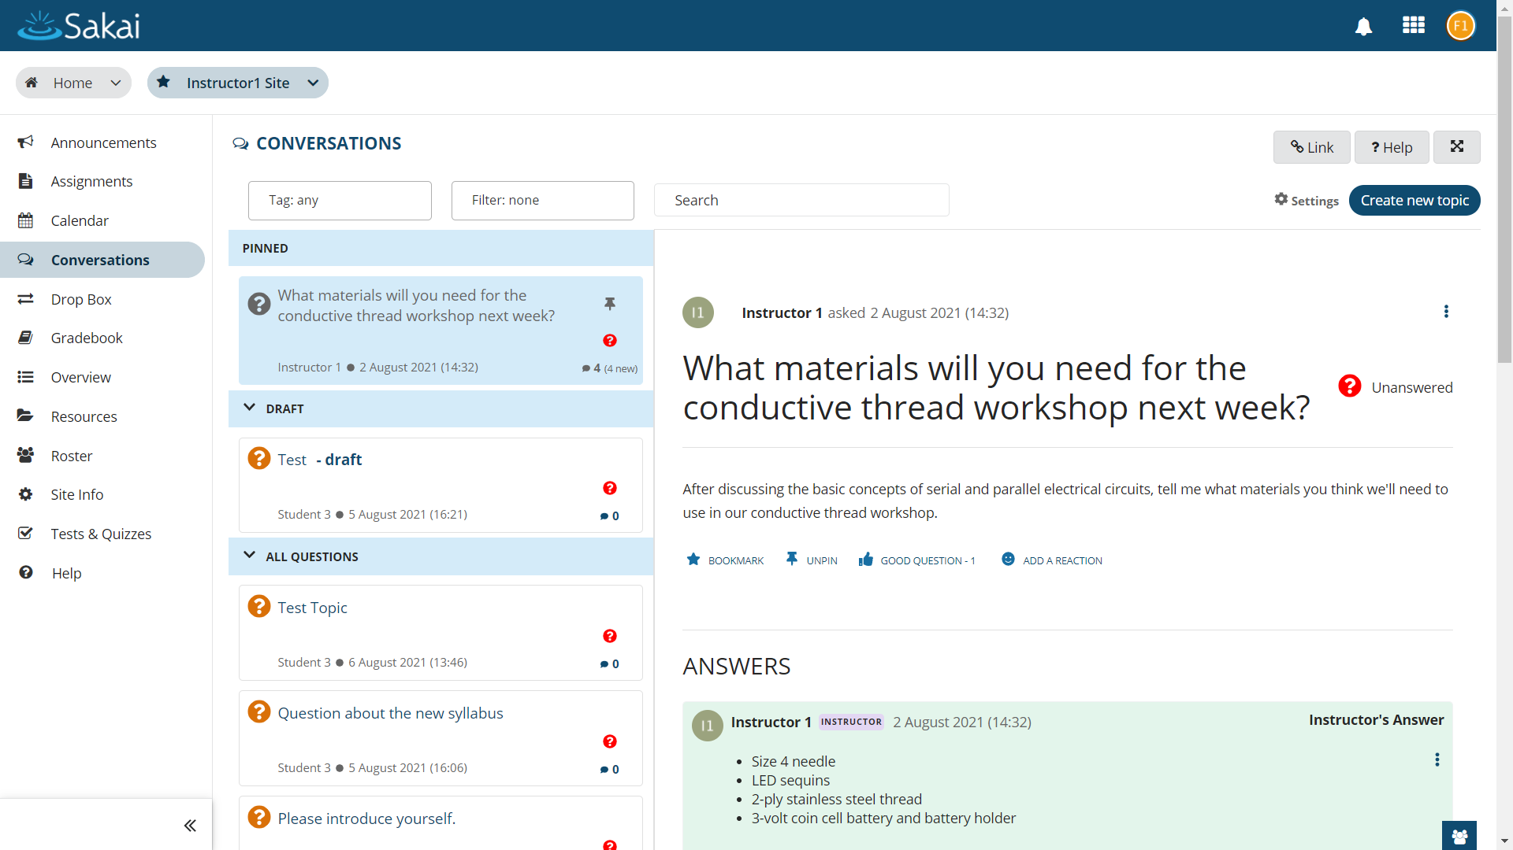
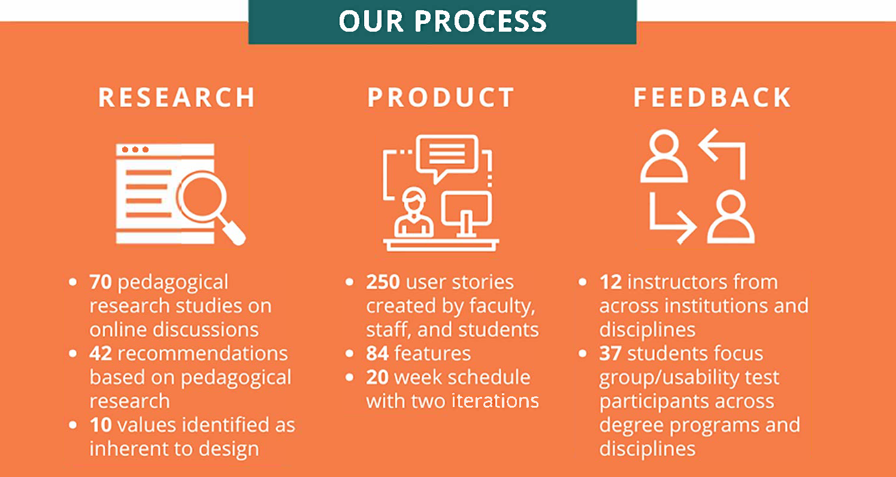
Faculty & Students First
Sakai innovates by soliciting the best ideas of instructors and students.
Learn more: bit.ly/Sakai-Conversations
Notes:
Sakai Conversations offers a new, thoughtful approach to online conversations, and it exemplifies this Faculty and Students First approach.
As online discussion has become even more important in so many courses in recent years, there was a huge need for a tool that would provide a great experience for both anonymous Q&A and threaded discussion.
Conversations grew with a great deal of feedback from Duke instructors and students.
250 user stories from faculty, students, and staff
12 instructors participated weekly in an advisory group during Summer and Fall 2021. (Most from Duke, some from other Sakai institutions.)
37 students gave feedback in focus groups.
Faculty input of a different kind was equally critical, as the design of Sakai Conversations was informed by findings from a review of 70 pedagogical research studies.

Slide 20

Faculty & Students First
Notes:
While we’ve got big plans for Sakai Conversations, the version available right now Is already really powerful.
Here’s a short clip, just 90 seconds, to show you what Sakai Conversations looks like today.

Slide 21
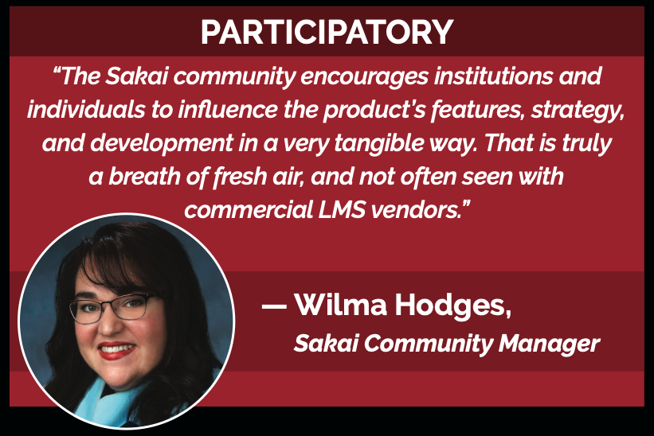
Notes:
Sakai’s innovation is participatory. Sakai Community members get a real say in how the product evolves over time. Among LMS’s, that’s unique to Sakai.

Slide 22

Participatory
Sakai’s Roadmap…
Innovative, Responsive, and Open.
Learn more:
bit.ly/Sakai-Open-Roadmap
Notes:
Our 3-year open roadmap emerges from a highly collaborative process each winter.
Community members get several opportunities to comment on, and help shape, this roadmap as it moves from draft to adoption.
We make this roadmap available to all, and you can review it at the link on this slide.
We’re more open than any of our competitors about the exciting stuff that’s to come.

Slide 23
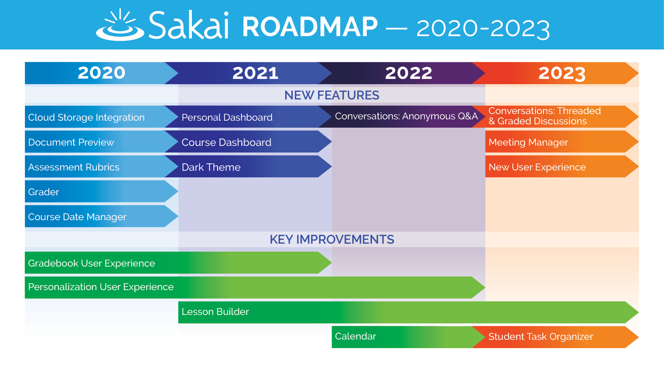
Participatory… and Delivering
Learn more:
bit.ly/ Sakai-Open-Roadmap
Notes:
Here’s a summary of the forward progress that’s been spurred by the commitment to our roadmap over the past few years.
Looking ahead into the near future, there’s lots more to come.
Every year since 2020 has seen significant expansion of Sakai’s capabilities, plus meaningful improvements to existing tools.
In 2020, Sakai gained 5 new major features, 2021 saw a major new tool and lots of key usability enhancements, and 2022 is the year of release for Sakai Conversations.
Looking ahead to 2023, there will be further improvements to Conversations, new ways for students to keep themselves organized, and an all new Meetings Manager tool that will make it easier to organize synchronous online discussions.

Slide 24
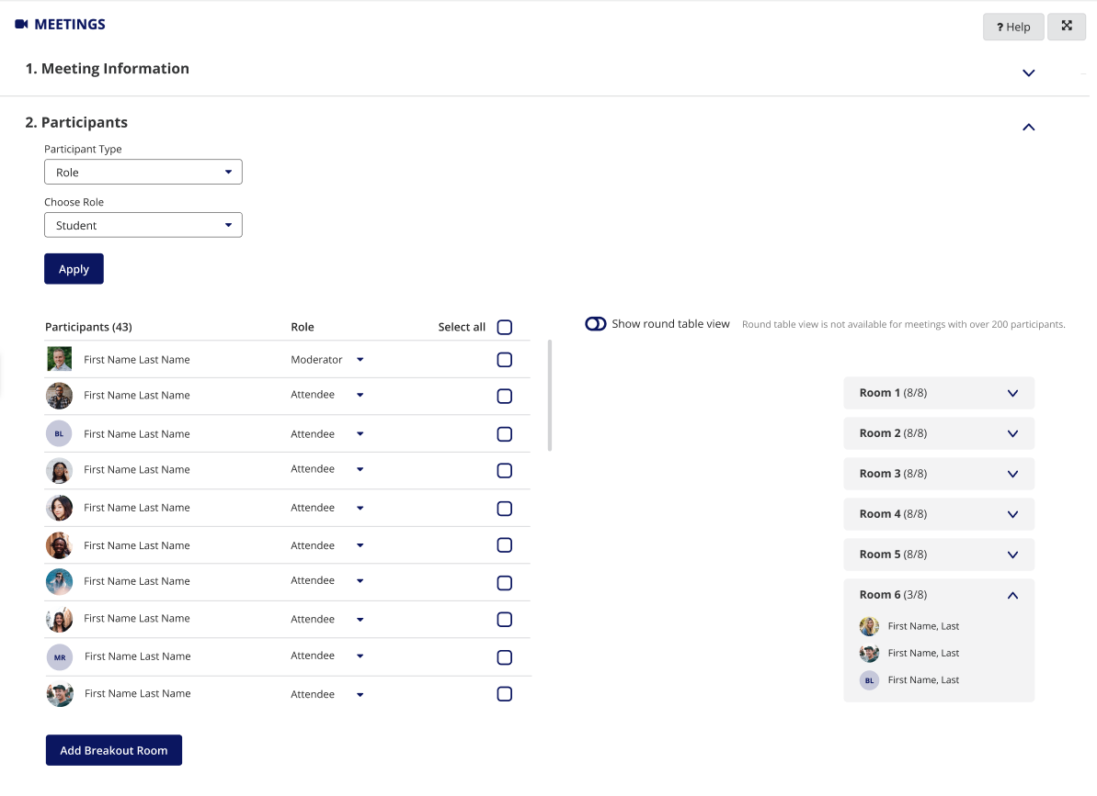
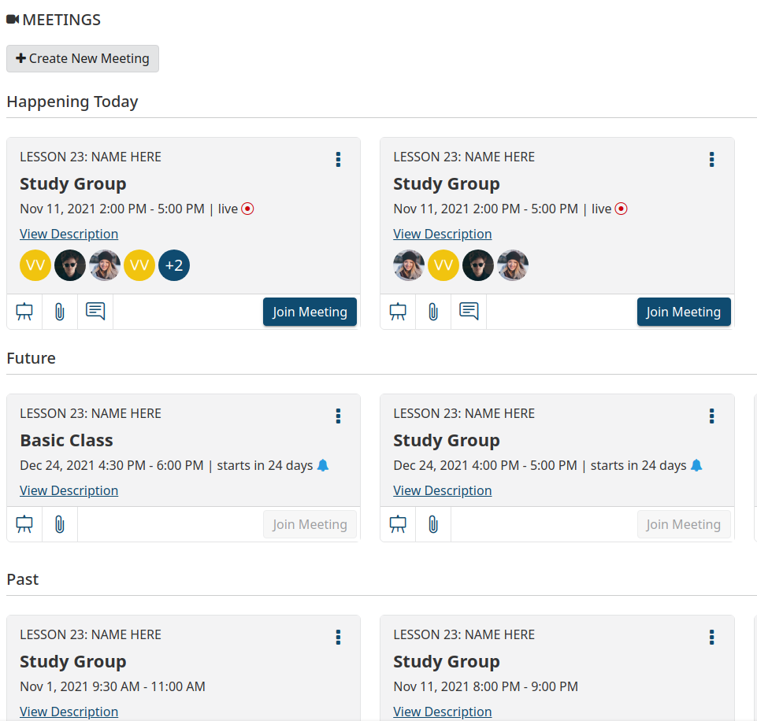
Participatory… and Delivering
Notes:
Here is a tiny preview of the new Meeting Manager tool, which will integrate with Microsoft Teams and Zoom.
We’ve been inspired by the experience you might get by peeking through a door into a classroom before entering – who’s in there, what’s being discussed?
Sakai’s already deep support for groups within courses lets Meetings offer management of breakout rooms that seeks to level up on the capabilities already in MS Teams and Zoom.

Slide 25
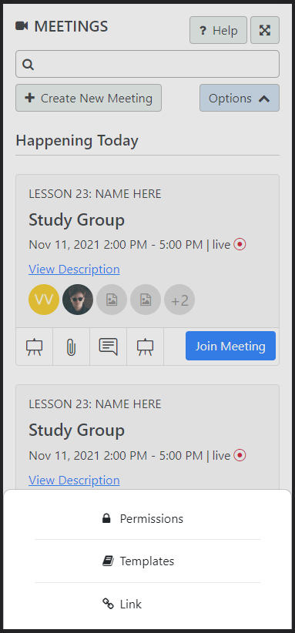
Participatory… and Delivering
Notes:
And because students participate in courses and project teams from wherever they are, Meetings is designed to look and work great on mobile too.

Slide 26
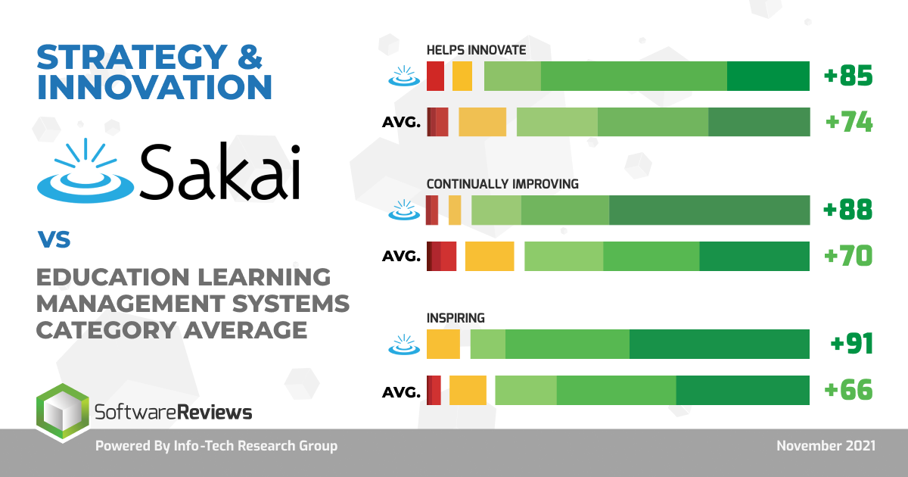
Most Innovative
Notes:
Based upon a market study of reviews from more than 1000 expert LMS users, Sakai experts already view Sakai more positively than Canvas experts view Canvas, etc.
This is also true of our innovation trajectory. According to this analysis, Sakai’s pattern of innovation and improvement is incredibly strong.

Slide 27
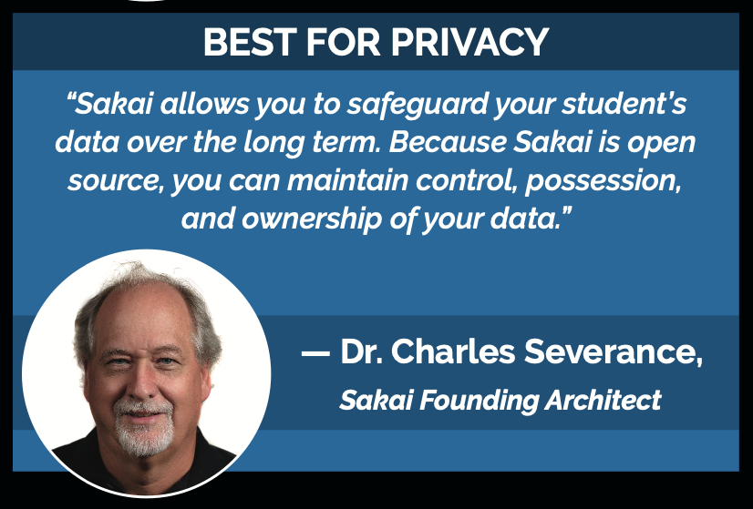
Notes:
Finally, let me say a few words about why Sakai is Best for Privacy.
Because Sakai is open source, institutions can maintain control of their student data by running Sakai in an on-campus data center or in the cloud with full contractual control of student educational records.
How do we make this possible?
With expert commercial affiilates who can help. Like my firm, Longsight.

Slide 28



Sakai at scale since 2005 ◉ 100 institutions hosted ◉ Deep expertise and a personal touch
Expert
Consultation
Managed services in your data center
Cloud
hosting
A Broad Array of Sakai Services
“Longsight’s expertise and professionalism has made a significant impact and inspired great confidence at the University of Dayton.”
— David Bauer, Director, University of Dayton
“[Longsight] exemplifies one of the best relationships we’ve had with a vendor. They’re collaborative in nature and they’re responsive….”
— Alan Regan, Director, Pepperdine University
Notes:
Let me say a few words about Longsight.
Some of you in this room remember me when I was at Brandeis University previously for 12 years in an IT leadership role, and that institution never had a service provider like Longsight.
We’re giving you today the wide range of Sakai options that you’ll need tomorrow – from expert consultation when you need it to full Sakai hosting in the Amazon cloud. And Longsight service agreements give you full contractual control of your student data.
We’re leaders in the Sakai Community, coordinating Marketing, Product, Technical Release, Community engagement, and more.
Everyone on our team has 10+ years of experience working with Sakai.
Several have been around since the Sakai’s birth in 2005.
I’m the new guy, with 5 years at Longsight and 20 years previously in higher education.
We’re small, with minimal turnover.
When you work with Longsight, you know us all by name and we know your team.
It’s an unusual approach, and it’s how we make a difference for colleges and universities.
—-----------
Hosting clients -- Longsight.
Illinois State University. 21k students.
Brock University. 19k students.
Duke University. 15k students.
Integral part of Sakai Community.
Nearly half of Sakai management team (PMC). 6 of 15 PMC member represented.
Lead in key areas: Overall community alignment, Internationalization, Marketing, Product, Release, Security.
Deep Sakai expertise & functional knowledge.
Combined: Many decades of Sakai experience.
We’ve worked in higher education, so we understand your needs.

Slide 29
Sakai Plus Demo
Notes:
Let me turn things back over to my mad scientist friend here for a quick look at Sakai Plus.

Slide 30
Student
Information
System
Canvas
Blackboard
Brightspace
...
LTI Advantage
SSO / Launch
Synchronized roster
Synchronized grades
Deep Linking

Slide 31
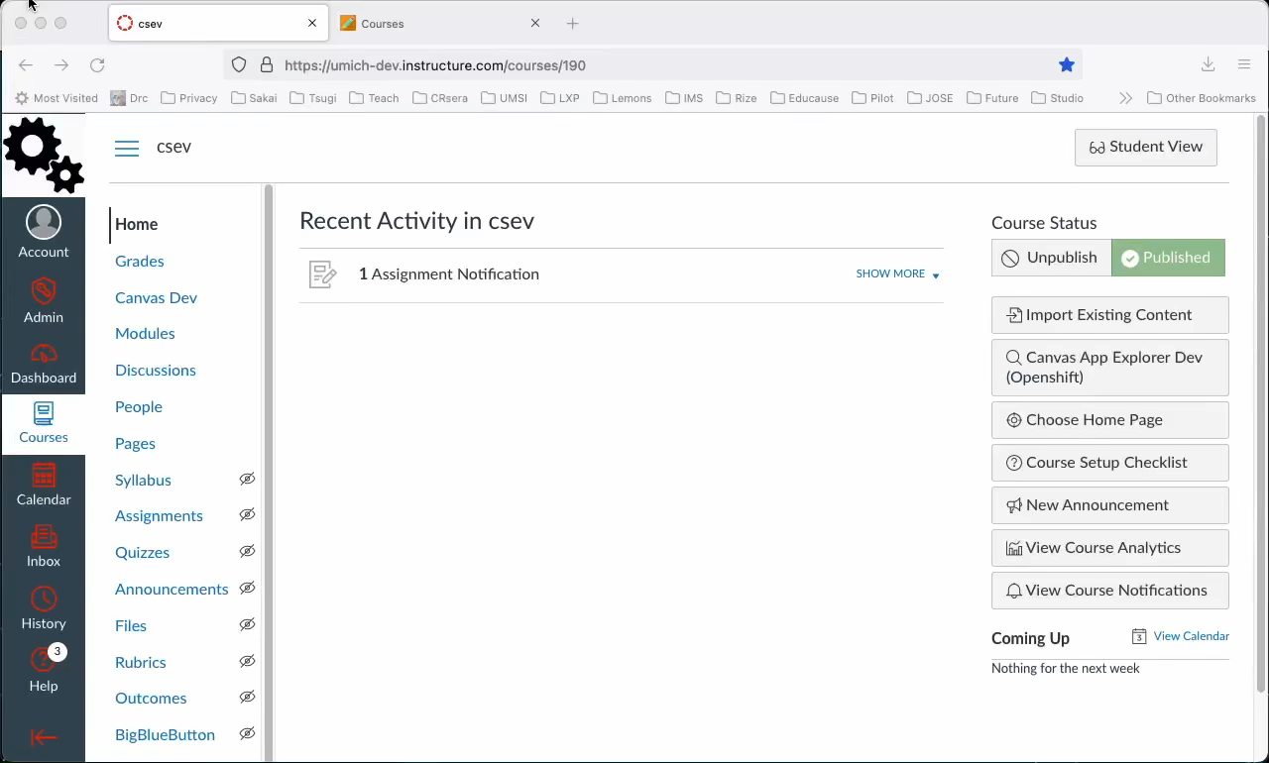
Notes:
While we’ve got big plans for Sakai Conversations, the version available right now Is already really powerful.
Here’s a short clip, just 90 seconds, to show you what Sakai Conversations looks like today.

Slide 32
ASU Dreamscape Learn

Slide 33
Questions?
Learn more:
SakaiLMS: www.sakailms.org
SakaiPlus: plus@sakailms.org
Notes:
SD

